Slide 1
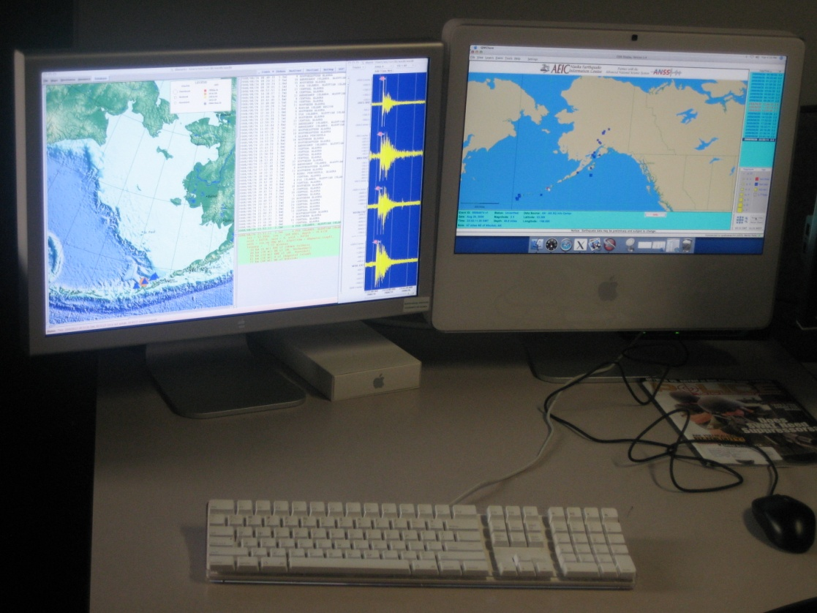
Delivery of Earthquake Notification Systems to Emergency Operations Centers in Alaska
Glenn Thompson
Geophysical Institute, University of Alaska Fairbanks

Slide 2
Identifier | Physical address for deployment
Fairbanks EOC | Fairbanks North-Star Borough Emergency Operations Center, 3175 Peger Road, Fairbanks, AK 99709-5499
Fort Richardson | State of Alaska Division of Homeland Security and Emergency Management State Emergency Coordination Center, National Guard Armory, Fort Richardson, Anchorage.
Anchorage Muni EOC | Municipality of Anchorage Emergency Operations Center, 1305 E Street, Anchorage, 99501.
Seward EOC | Seward Fire Department (City Emergency Operations Center / Dispatch), 316 4th Avenue, Seward.
Soldotna EOC | The Kenai Peninsula Borough Emergency Operations Center, 253 Wilson Lane, Soldotna, 99669.
Valdez EOC | Valdez City Hall, 212 Chenea Ave. Valdez
Kodiak EOC | Kodiak Island Borough Police Department, 217 Lower Mill Bay Road, Kodiak.
EOC Project:
Funded by DHS/FEMA
coordination Mark Roberts, Ervin Petty, Roger Hansen
Develop an earthquake notification system that can be deployed at seven emergency operations centers in Alaska
Steps:
Choose applications (Antelope, CISN_Display)
Choose computer hardware / operating system
Purchase hardware
Develop new Antelope software (dbevents_aeic, dbsubset2orb, orbsegment, …)
Configure computers
Install them

Slide 3
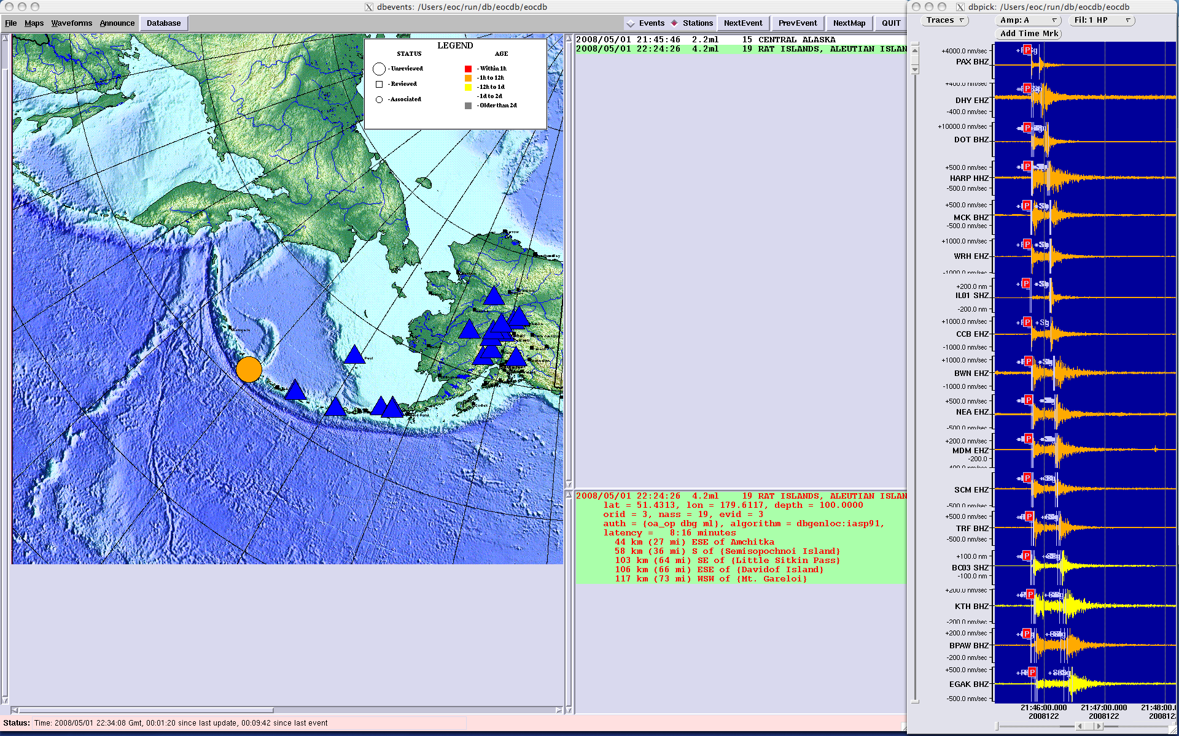
Computerised voice announcement for M >= 4.0
Detailed maps, showing faults
ShakeMaps

Slide 4
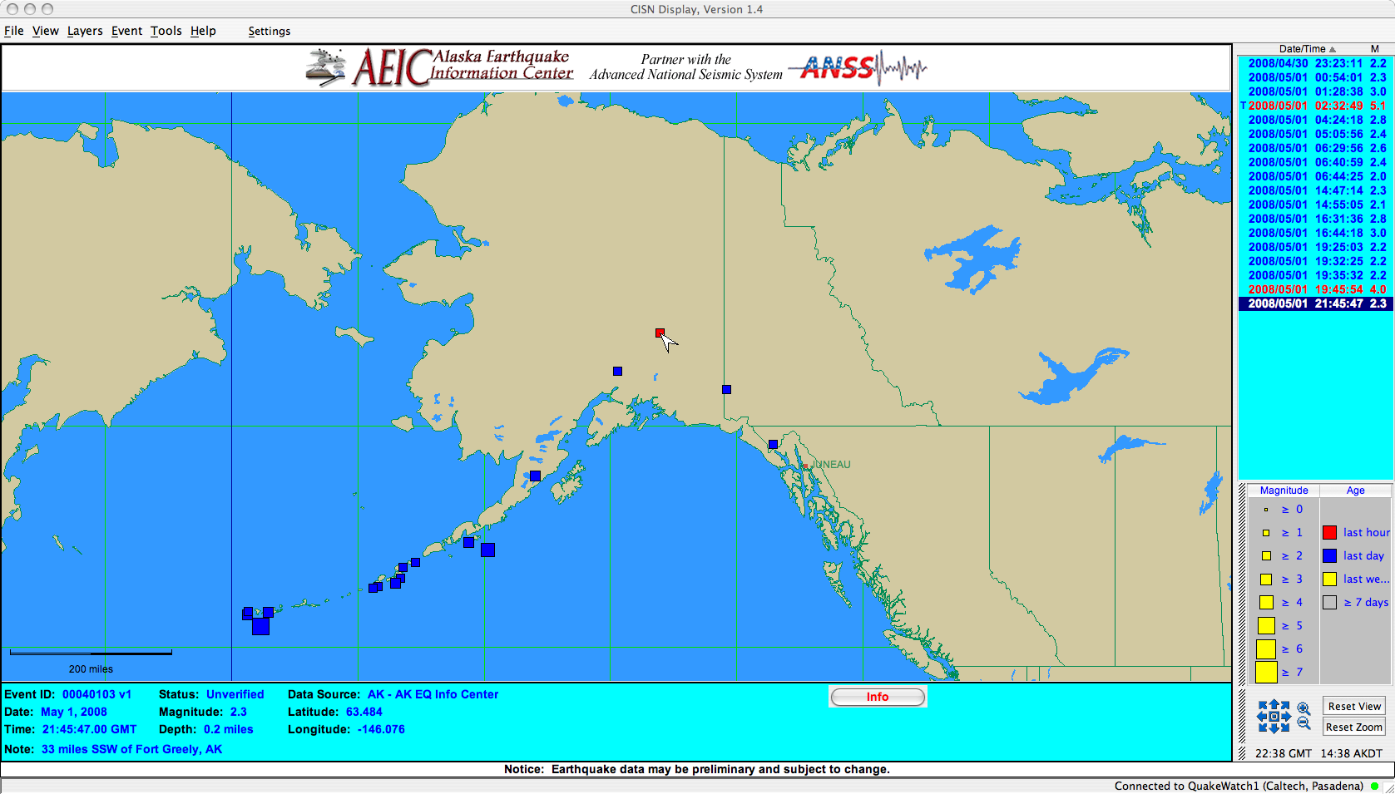

Slide 5
dbevents_aeic
PROS:
How we see the data
Events are announced by a computerised voice (if M> 4.0)
Runs on MacOS, Linux and Solaris
Latency
Waveforms
Detail maps with faults
(ShakeMaps)
CISN_Display
PROS:
Designed for emergency managers (tailored)
Simple, but limited
Free (subscription required)
Runs on Windows too
Quick to install / configure
Can add new layers
ShakeMaps in web browser
Tsunami Bulletins in web browser

Slide 6
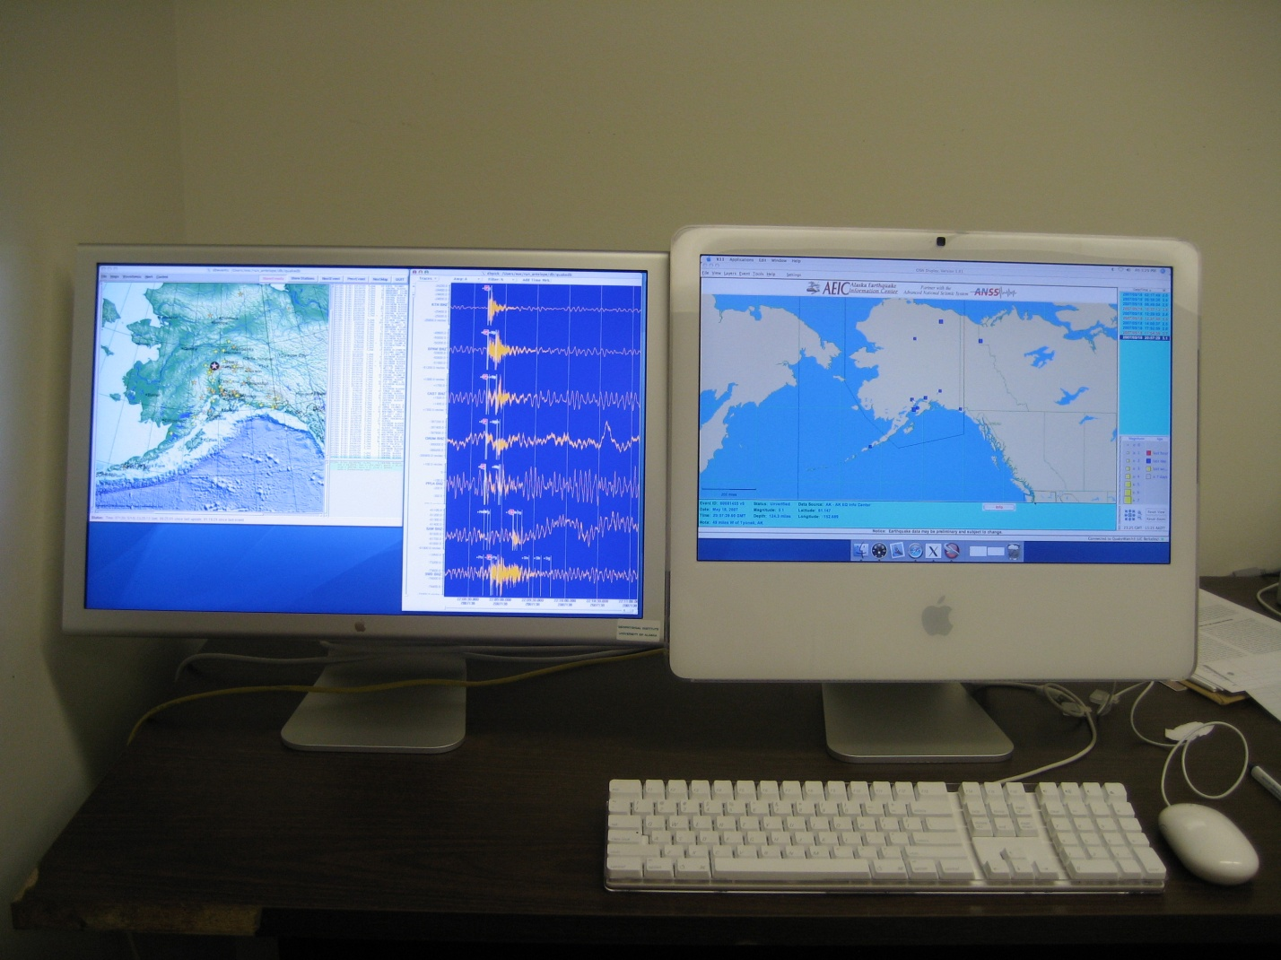
CISN_Display
Antelope / dbevents_aeic

Slide 7
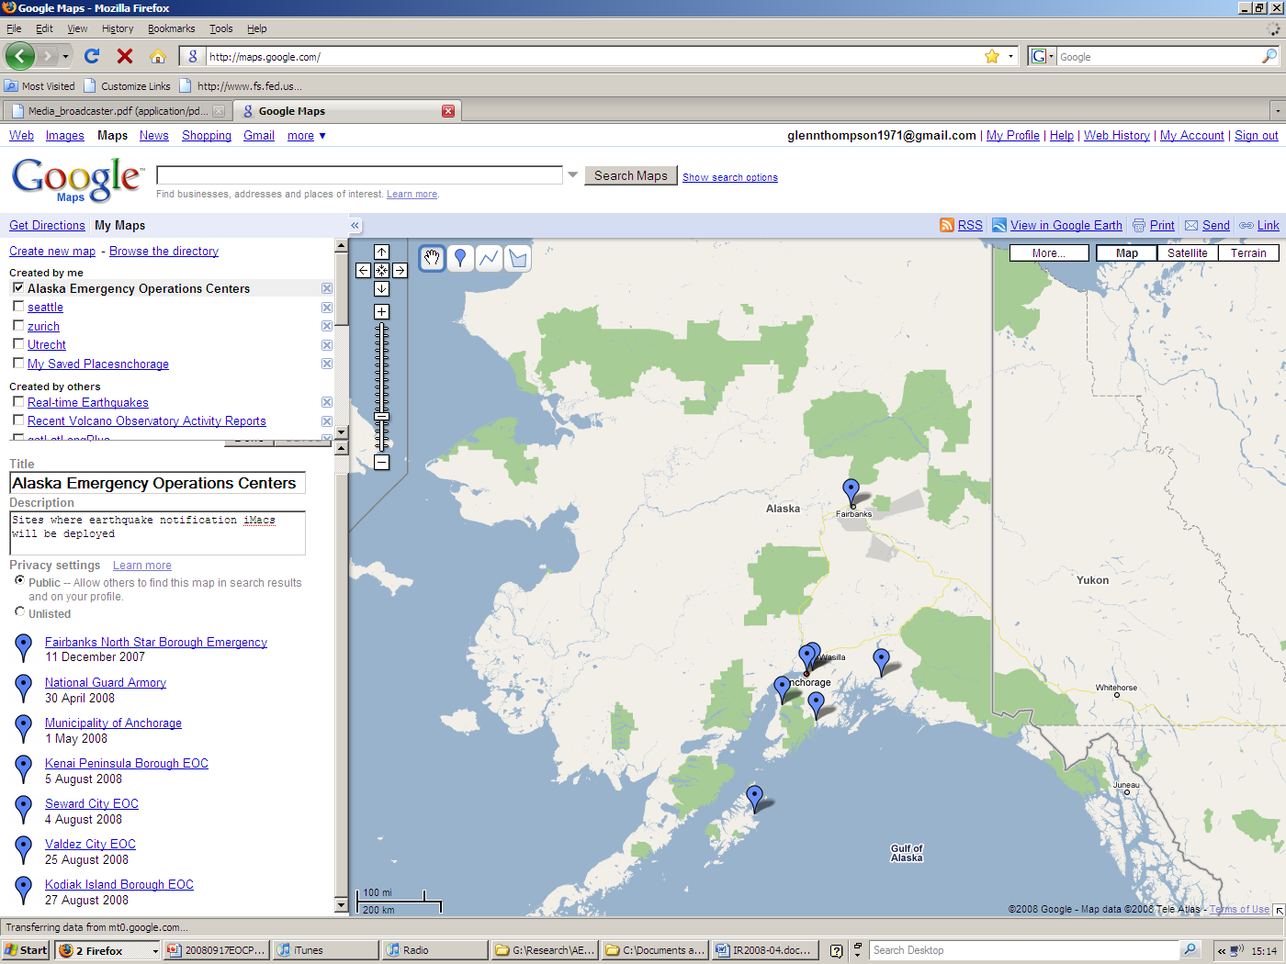
Installation Scheudle
Installation Dates

Slide 8
Reports
Quarterly reports (March 2007 – September 2008)
User guide (AEIC report 2008-05)
Installation & configuration guide (AEIC report 2008-06)
Project report (AEIC report 2008-04)

Slide 9
Things we need
Funding to purchase, configure and install iMac
Networking / Firewall configuration
1 day to configure iMac
1 day to install iMac (+ travel time)
Feedback: how can we make it better?
See the system during lab tour

Slide 10
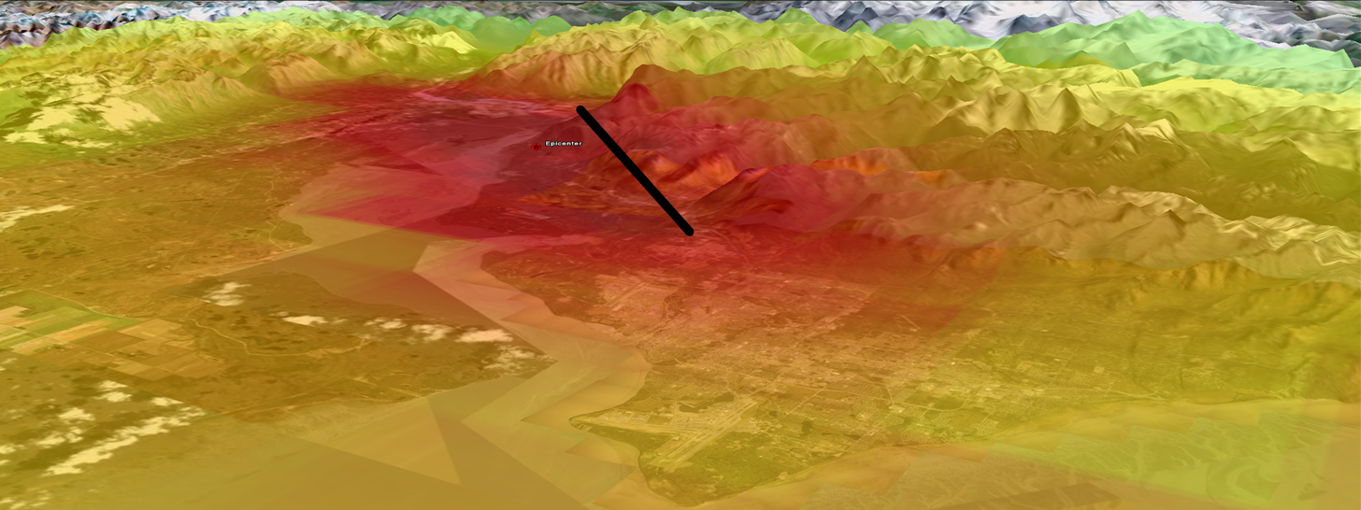
Implementation of the ShakeMap System in Alaska
by Artak Martirosyan and Glenn Thompson
Geophysical Institute, University of Alaska Fairbanks

Slide 11
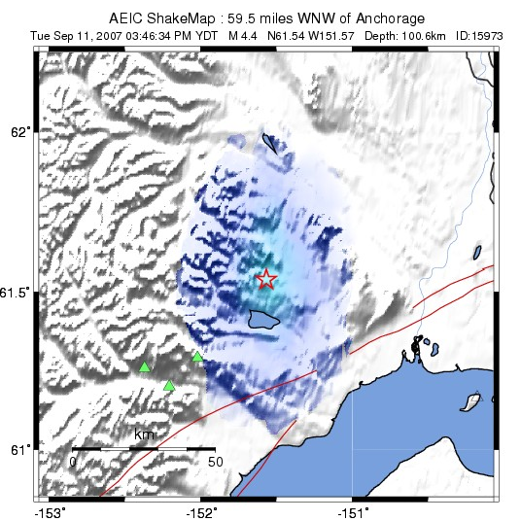
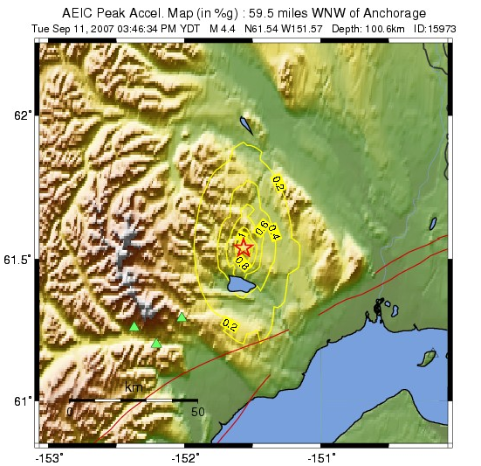
SHAKEMAPS
ShakeMap archive webpage
USGS ShakeMaps Alaska

Slide 12
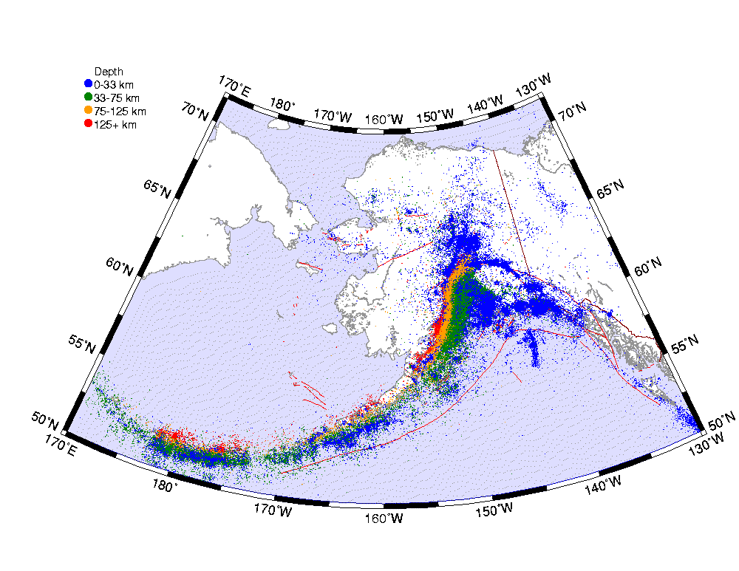
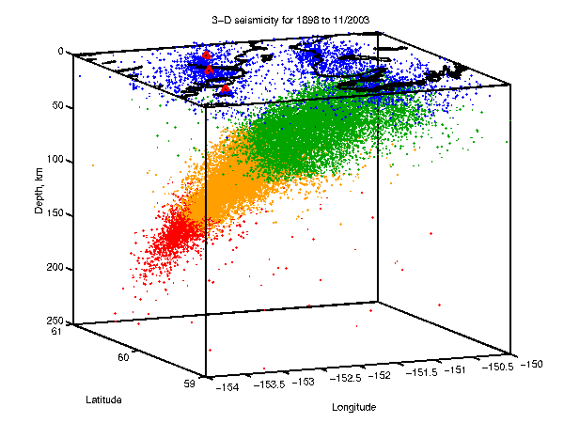
Earthquakes in Alaska
AEIC Catalog of Earthquakes in Alaska: 1898 - 2006
> 250,000 to date
average 45-90 per day
M > 4, 1 per day
M > 5, 1 per week
M > 6, 1 per month
Notes:
This is the result of our Operations which Jamie talks about – our catalog.
This is Cook Inlet / Augustine region.
Different depth of earthquakes, different colours.
Seismicity concentrated on megathrust – because of plate tectonics. Events get deeper in the subduction zone as you go north.
Shallow crustal seismicity driven by Yakutat block.

Slide 13
Magnitude, Amplitude & Energy
For each increase in magnitude by 1,
Amplitude of ground shaking increases by 10,
Energy increases by 32
(Area represents earthquake energy)
M 5.0
M 6.0
M 4.0

Slide 14
Magnitude vs. Intensity
Parameters of the earthquake source:
longitude, latitude, depth, magnitude
Computed in near-real-time by AEIC Antelope system
Parameters that matter most to emergency managers, engineers, public:
Intensity (acceleration, velocity) -> damage
Computed in near-real-time by AEIC/USGS ShakeMap system

Slide 15
Magnitude | Energy compared to magnitude 1 | Fraction of all events | Fraction of total energy
< 2.0 | 32 | 8 / 9
2.0 – 2.9 | 1,000 | 1 / 9
3.0 – 3.9 | 32,000 | 1 / 80
4.0 – 4.9 | 1 million | 1 / 500
5.0 – 5.9 | 32 million | 1 / 5,000
6.0 – 6.9 | 1 billion | 1 / 25,000 | 1 / 24
7.0 - 7.9 | 32 billion | 1 / 200,000 | 1 / 5
> 8.0 | 1,000 billion | 1 / 3 million | 3 / 4

Slide 16
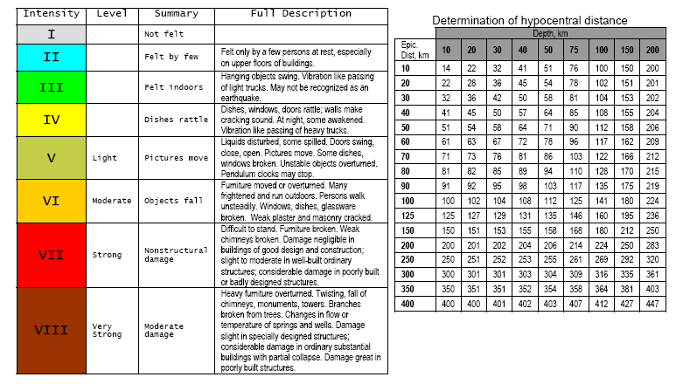
Modified Mercali Intensity (MMI) Scale
AEIC need to know about felt earthquakes (MMI >= 2)

Slide 17
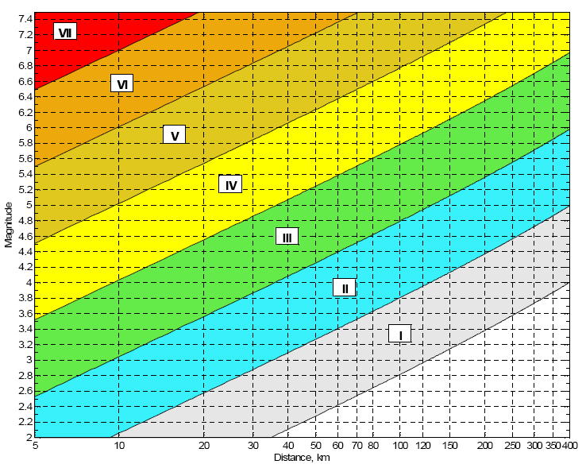
MMI scale
M = 3.5 at 5 km causes same shaking as M = 7 at 400 km

Slide 19
Attenuation Relationships
Boore et al. (1997) model is used for the crustal events with M>5.3.
Youngs et al. (1997) model is used for subduction-zone events.
ShakeMap Small Regression model for shallow events with M<=5.3.

Slide 20
Observed and Predicted PGA During the Denali M7.9 Earthquake

Slide 21
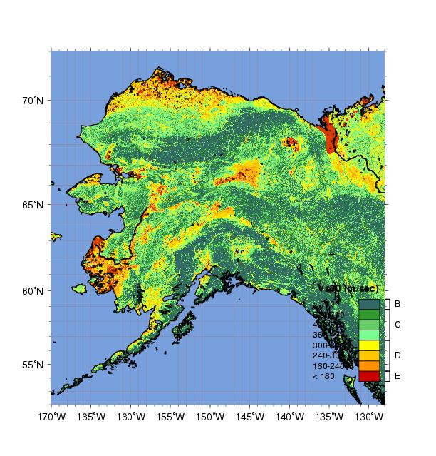
Vs30 Grid
The site corrections are based on the average shear-wave velocity values for the uppermost 30 meters (Vs30).
Vs30 values are derived from the slope of the topography.

Slide 22
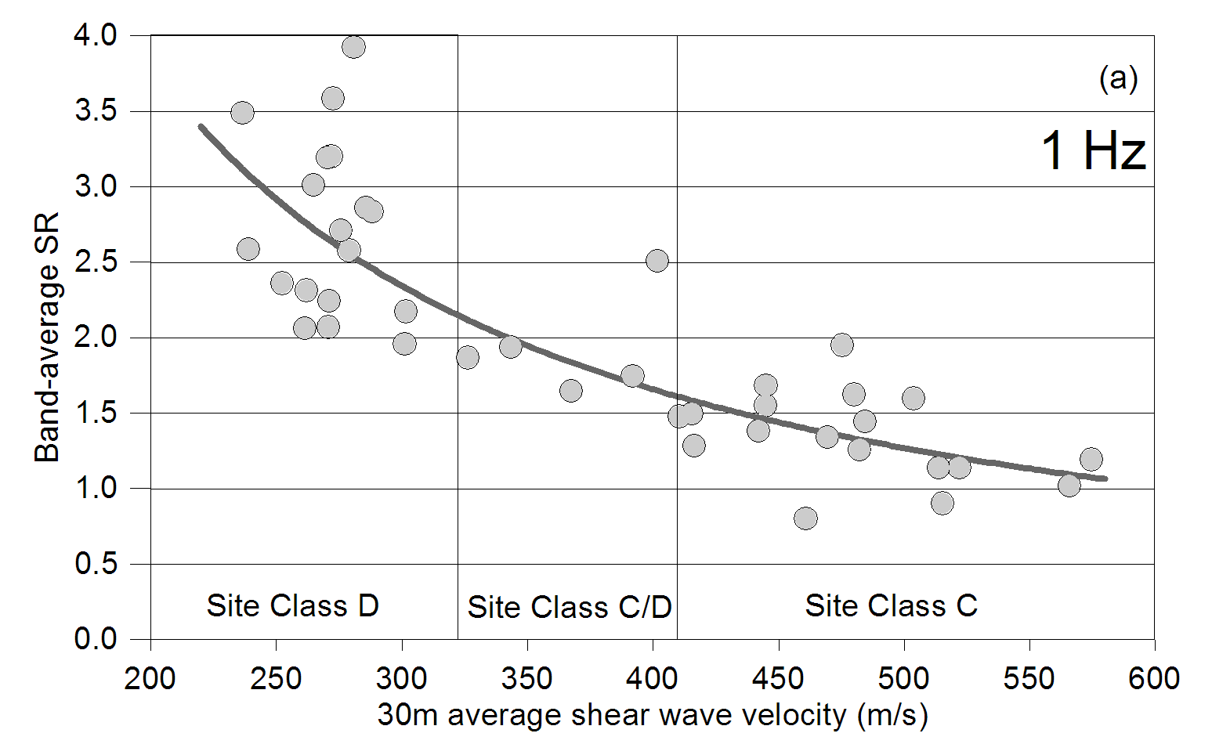
Correlation of Vs30 and Site Response in Anchorage

Slide 23
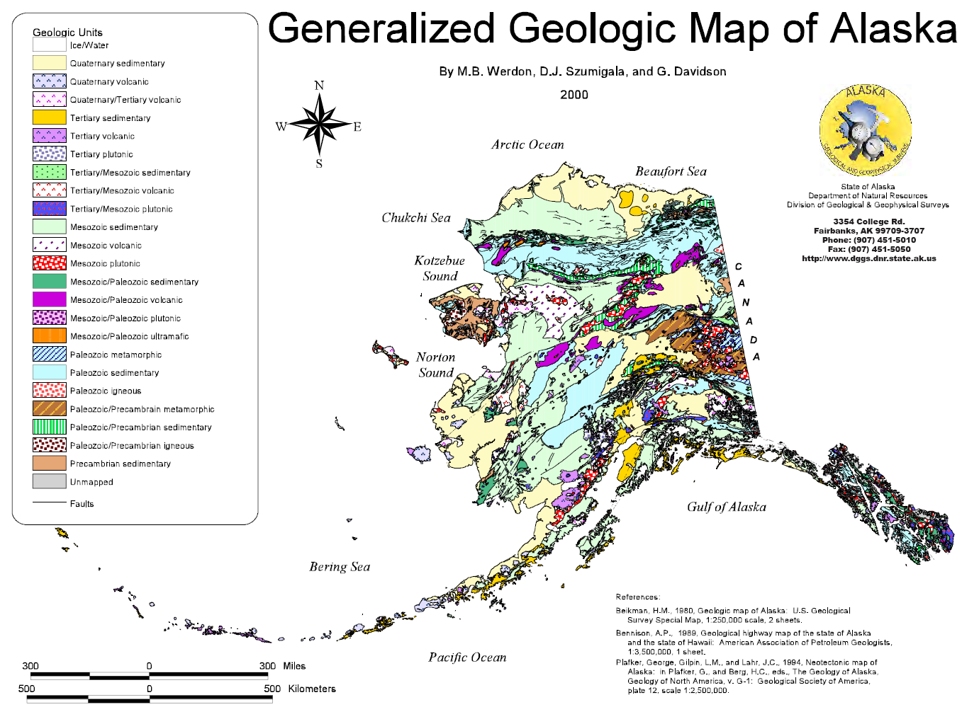
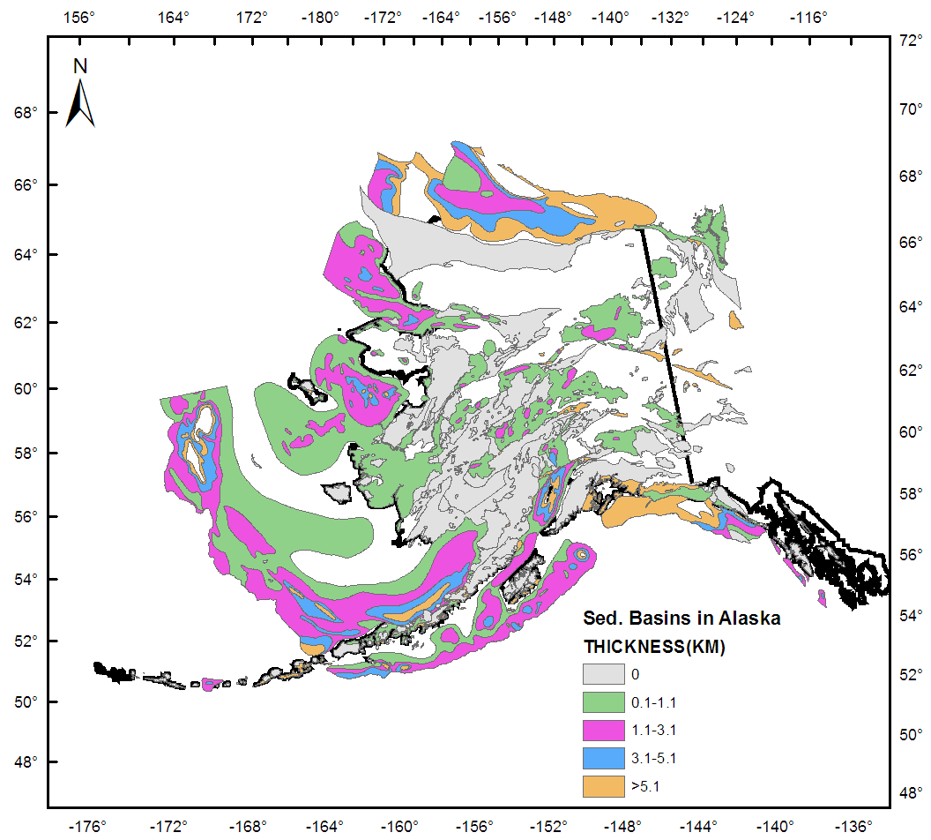
Geology Map

Slide 24
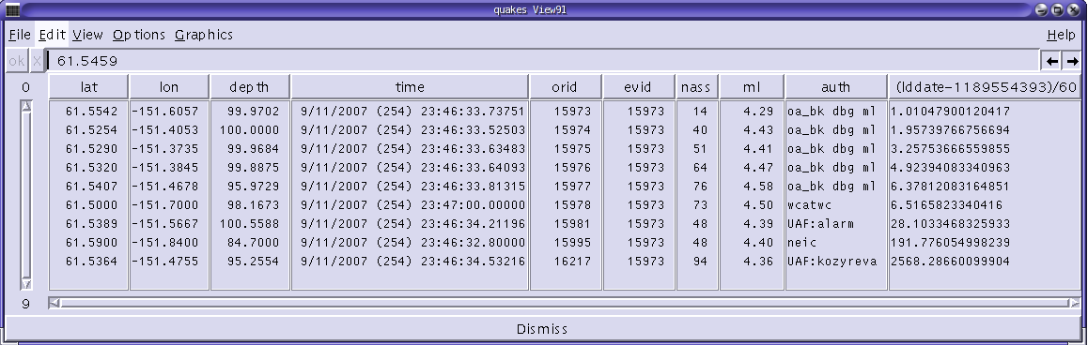
Summary Event Database
Ultimate product of near-real-time Antelope system

Slide 25
Typical sequence
00:00 Earthquake Occurs, waves propagate out like ripples on a pond
00:30 Waves have reached 4 seismic stations
01:00 Antelope declares origin 1 for this earthquake event
01:30 Antelope computes a magnitude for origin 1
01:35 Summary event database updated with origin 1
01:40 ShakeMap system detects new origin in summary event db
01:45 Waves have reached 10 seismic stations
02:15 Antelope declares origin 2 for this earthquake event
02:45 Antelope computes magnitude for origin 2
02:50 Summary event database updated with origin 2
03:00 ShakeMap system detects origin 2 in summary event db
06:30 ShakeMap website updated with origin 1
08:00 ShakeMap system updated with origin 2
… several updates may be automatically issued if new data becomes available from different sources.
30:00 Beeper Duty Seismologist relocates earthquake
40:00 ShakeMap system updated with this ‘preferred’ origin
… A final version of ShakeMap is manually produced for larger events, if necessary, in order to utilize any additional information, including extended source geometry.
.

Slide 26
DATA
Observations are collected from >80 broadband and >25 strong motion stations throughout Alaska.
Ground motion grids are based on maximum peak ground accelerations and velocities of two horizontal components.
Currently, ShakeMaps are produced for events with magnitudes greater that M3.5 with at least 10 associated arrival picks and calculated MMI greater than 2.0 at the epicenter.

Slide 27
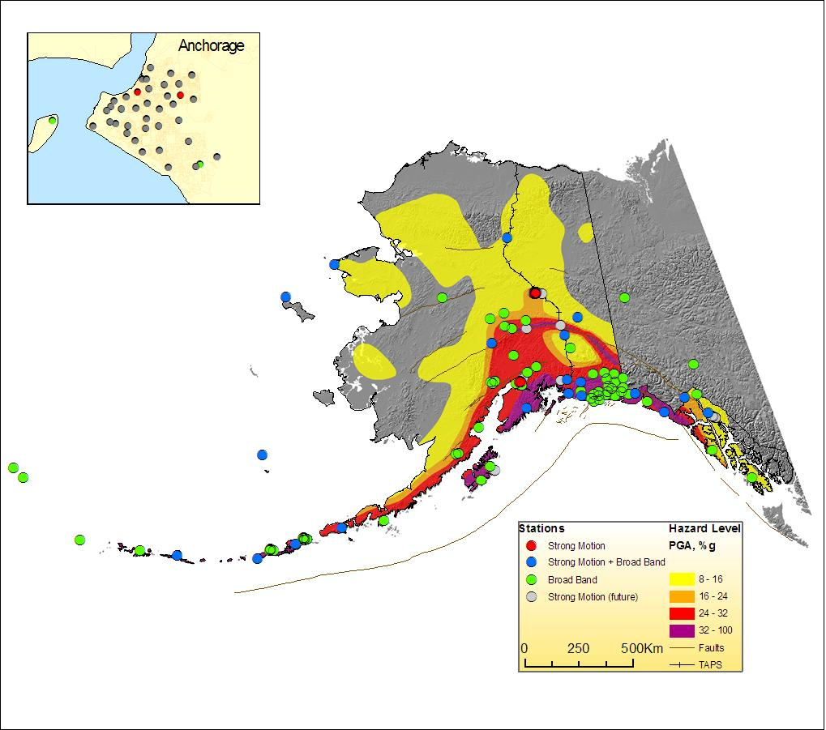
Map of Seismic Stations

Slide 28
ShakeMap Methodology
The ShakeMap triggering and production is based on the Antelope system used for real-time seismic operations at AEIC.
The ShakeMap generation sequence is triggered once a new event above certain magnitude appears in the real-time event database.
The first ShakeMap is automatically generated within 1-2 minutes after that, and then several updates may be automatically issued if new data becomes available from different sources.
Analyst-reviewed ShakeMaps are generated for alarm events after the revision of the automatic solutions, usually within 25 to 45 min of the origin time.
A cancellation script is activated if an updated hypocenter is no longer eligible for ShakeMap.
A final version of ShakeMap is manually produced for larger events, if necessary, in order to utilize any additional information, including extended source geometry.

Slide 29
REAL-TIME SYSTEM ARCHITECTURE

Slide 30
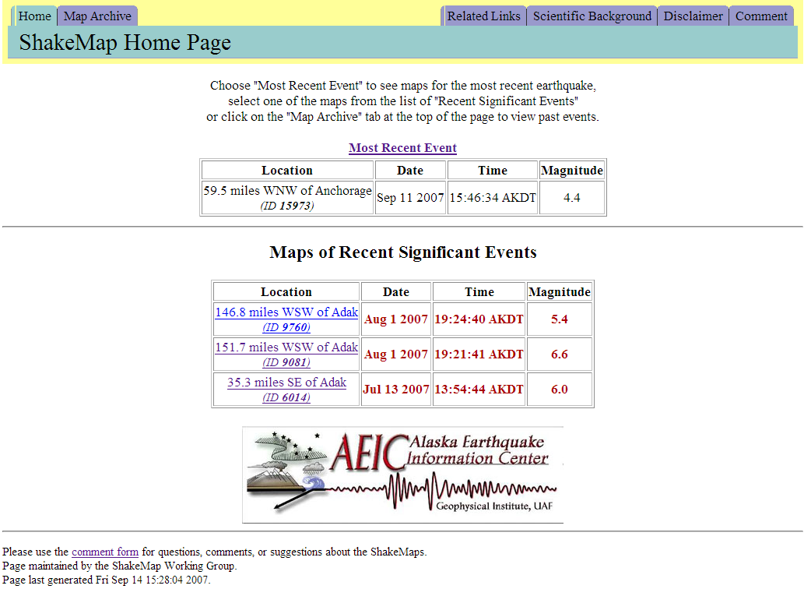
AEIC ShakeMap Homepage

Slide 31
SCENARIO SHAKEMAP
M7.1 earthquake on the Border Ranges Fault near Anchorage
Scenario ShakeMaps represents the expected ground motions from hypothetical earthquakes.
Earthquake scenarios play an important role in planning and coordinating emergency response and conducting training exercises based on realistic situations.
2002 Denali Fault Earthquake 7.9
1964 Alaska Earthquake 9.2

Slide 32
ShakeMap
a tool for the near-real-time generation of ground-shaking maps following significant earthquakes.
provides vital information within minutes after an earthquake to emergency response agencies, the media and the general public.
produced on the basis of observed ground motion values (peak velocities, peak accelerations, and spectral accelerations)
complemented by calculated values using empirical attenuation relationships.

